Slide 1
Multiple Linear Regression Predicting Cholesterol
Chris Park and Ben Johnson-Laird

Slide 2
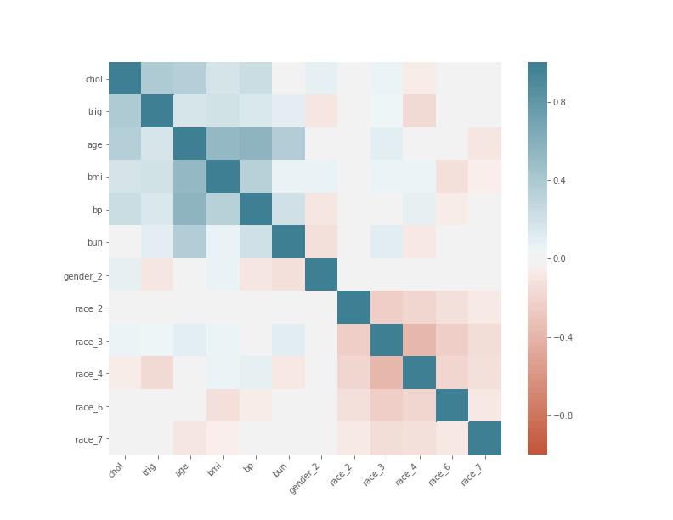
National Health and Nutrition Examination Survey (NHANES) (2013-2016)
16,881 survey respondents
Variables of Interest
Dependent Variable
Cholesterol - Chol
Independent Variables
Triglycerides - Trig
Body Mass Index - BMI
Blood Pressure - BP
Blood Urea Nitrogen - BUN
Age - Age
Gender
Race (7 Dummies)

Slide 3
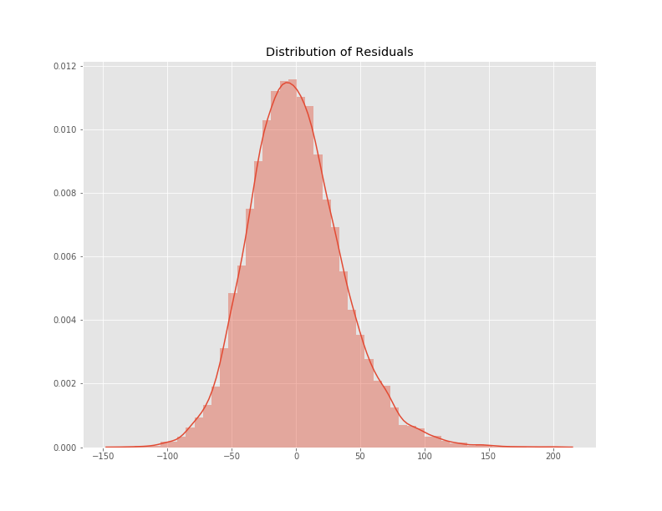
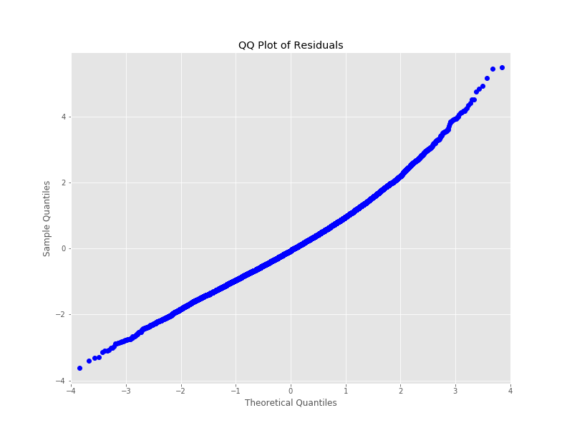
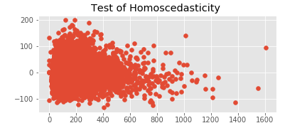
Assumptions
Distribution of Residuals
QQ Plot - Normality Testing

Slide 4
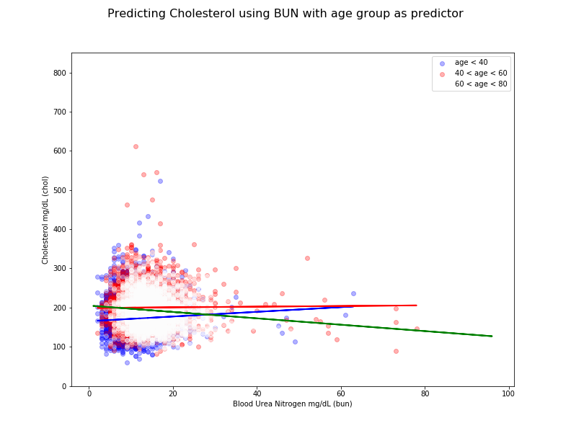

Slide 5
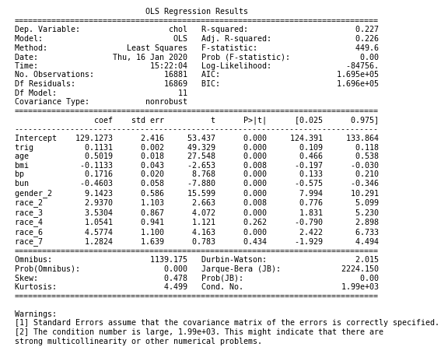
Predicting Cholesterol with no interaction & no interpolation for missing values

Slide 6
Enhancements to the initial model
Log transformation of all continuous variables
Min-Max Scaling
KNN Imputation of Missing Values
Interaction effect between age and BUN in predicting total cholesterol

Slide 7
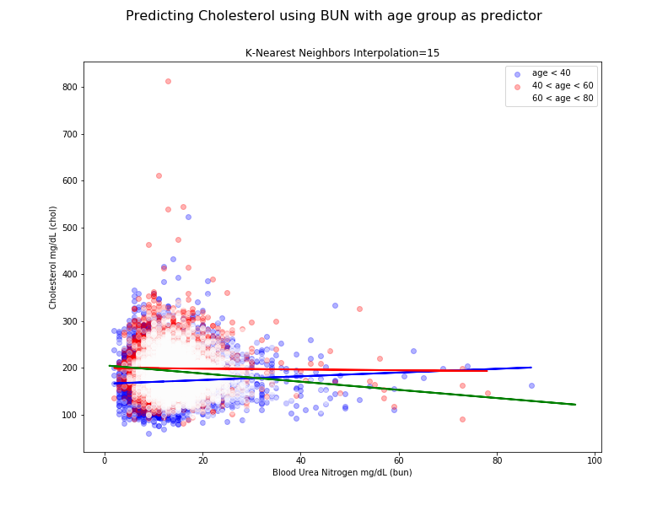

Slide 8
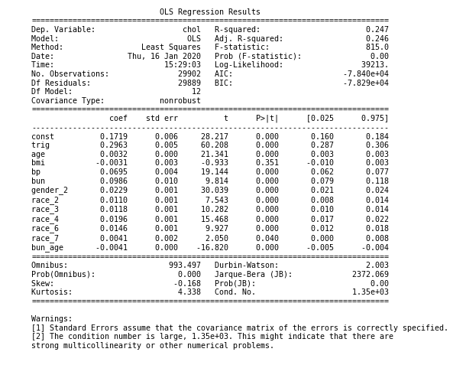
Predicting Cholesterol with K nearest neighbor interpolation for missing values (k = 15)

Slide 9
Conclusion
Overall Adjusted-R2 Score increases after log transformation and normalization
Both models were found to be statistically significant (p < 0.001)
Change in cholesterol levels were found to be different in older population

